Slide 1
INFO 7290: Business Intelligence (BI) & Data Warehousing
Software & Development Setup
SQL Server 2016

Slide 2
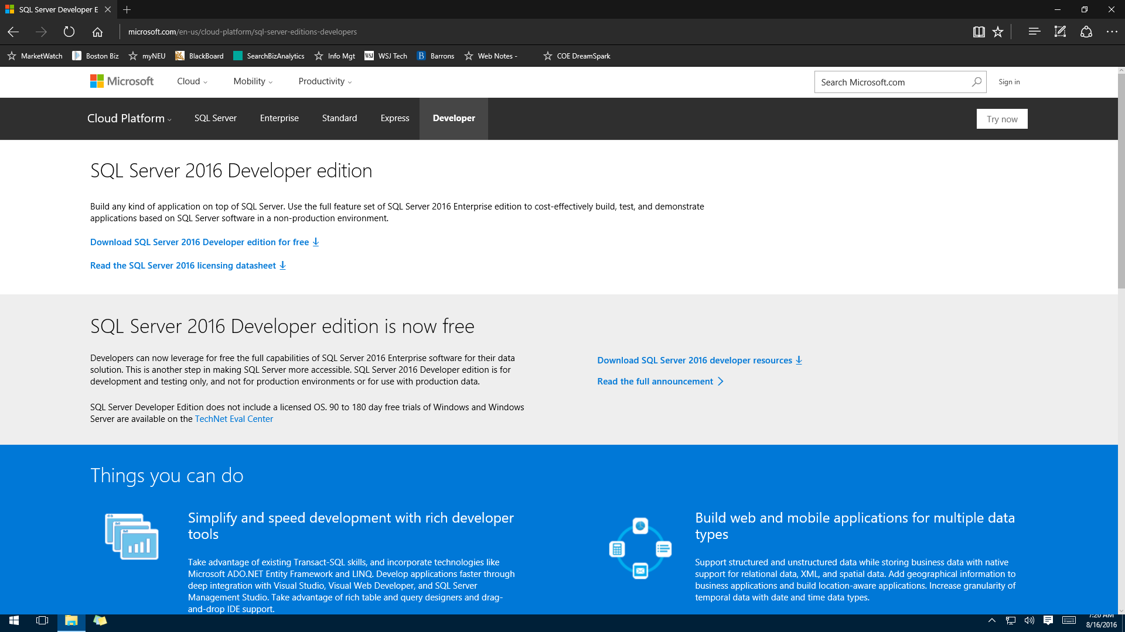
SQL Server 2016 SP Developers Edition

Slide 3
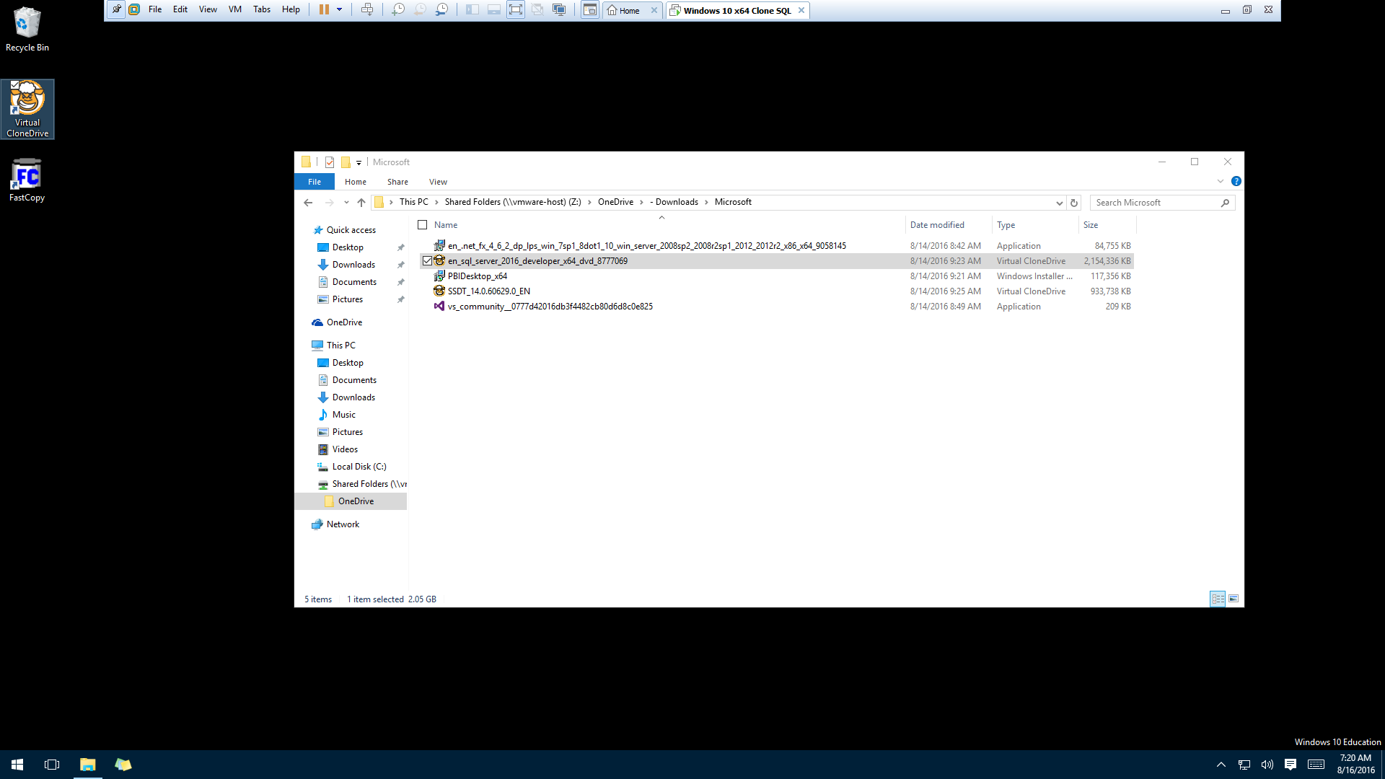
SQL Server 2016 SP Developers Edition
Your downloaded ISO file.

Slide 4
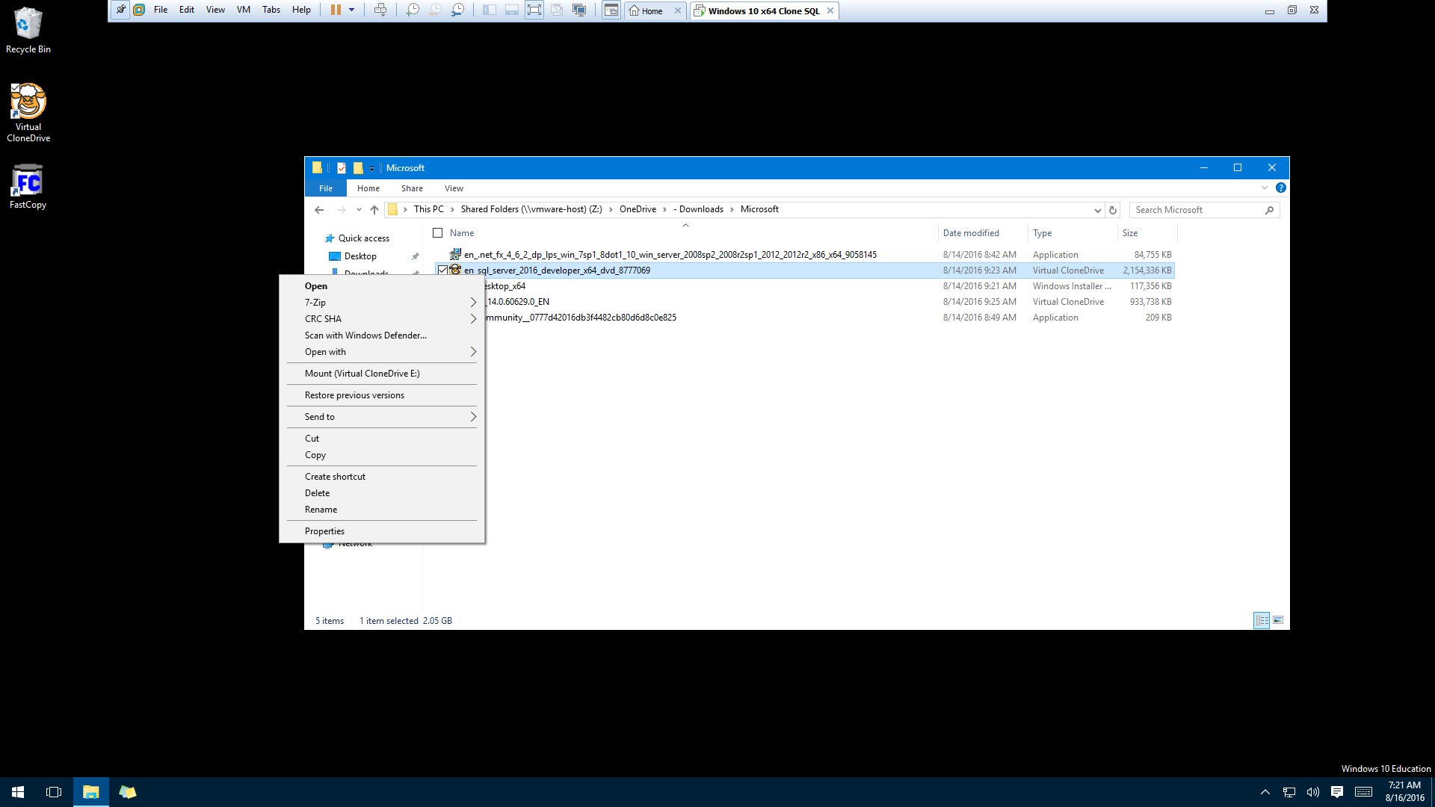
“Mount” iso file downloaded. Example uses CloneDrive but any applicable software is fine.

Slide 5
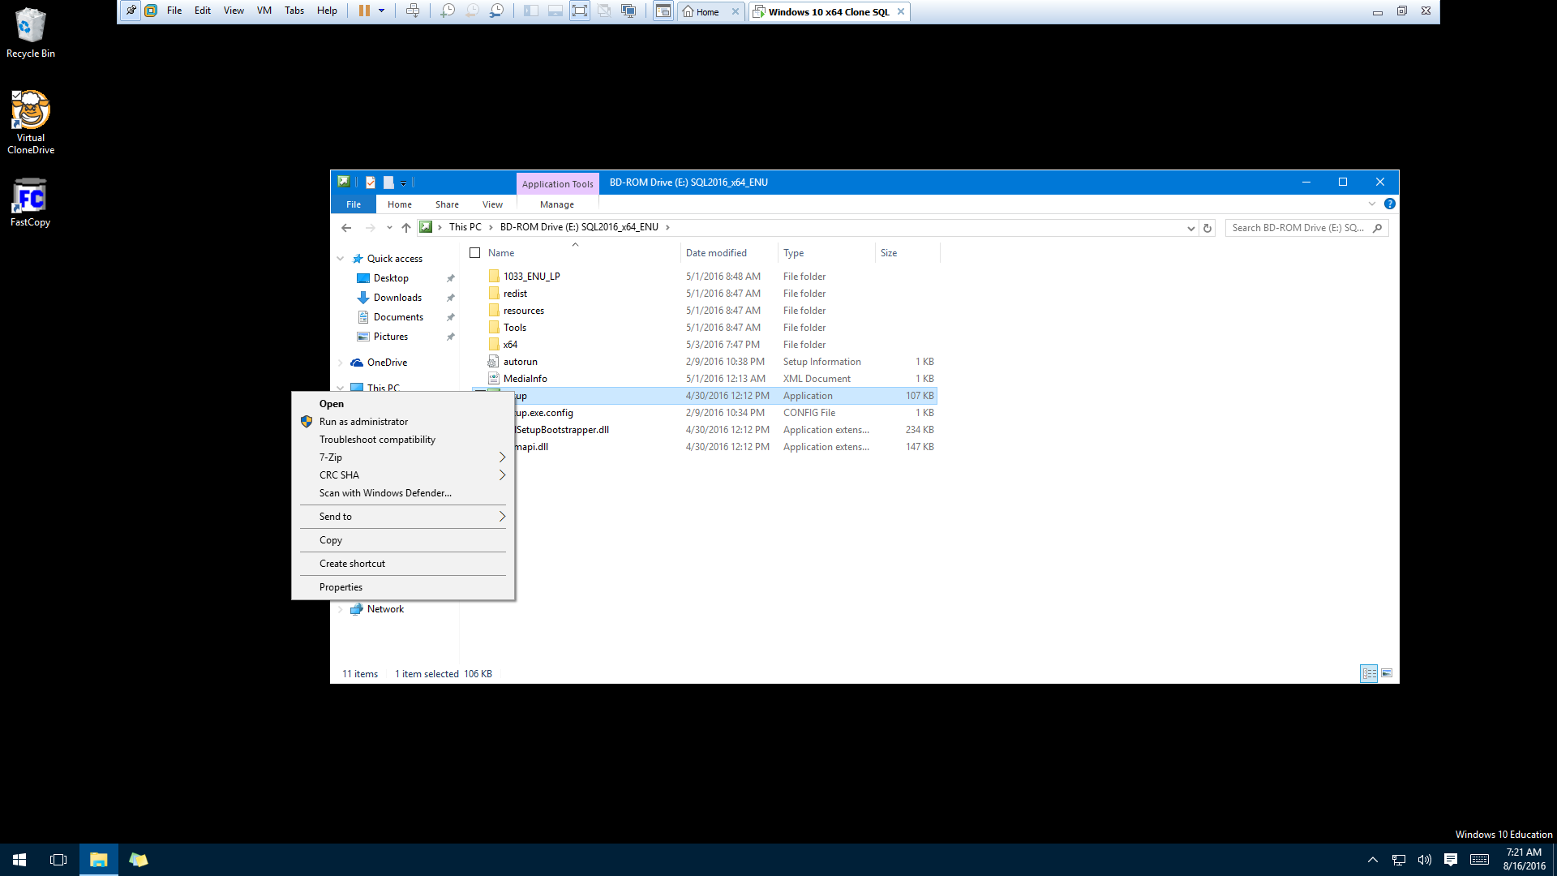
After disk mounted, then “Run as Administrator” the Setup file.

Slide 6
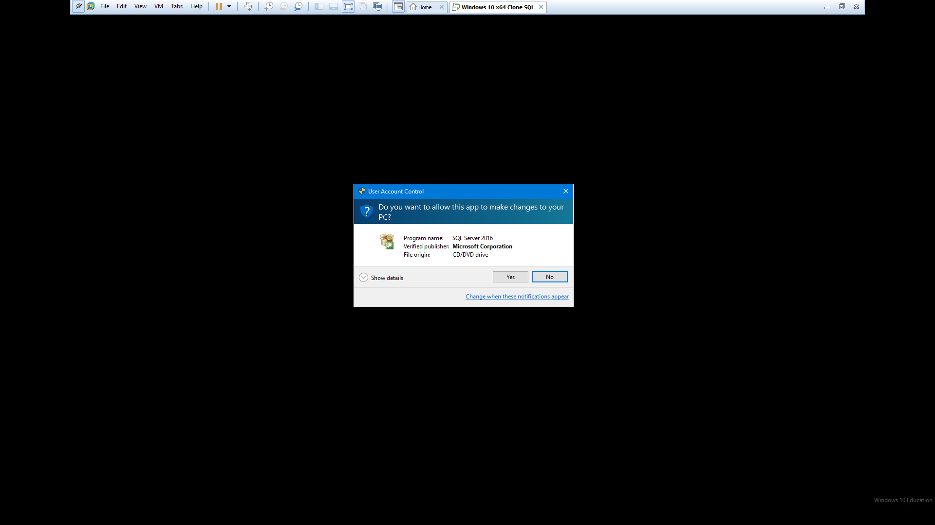

Slide 7
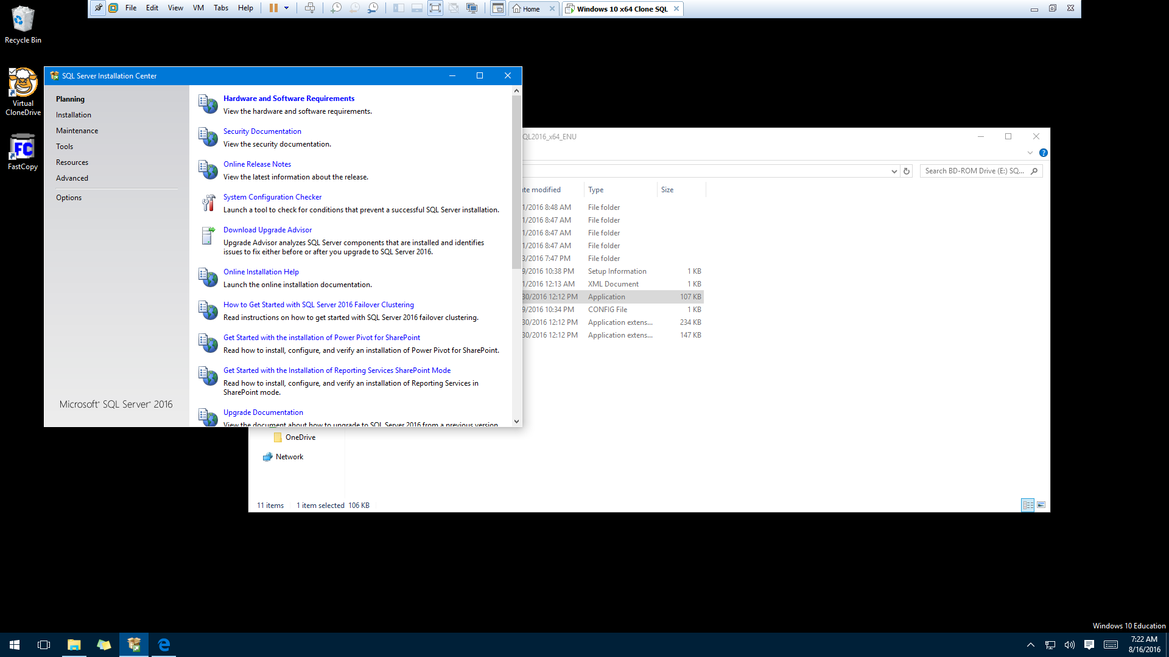
Select Installation

Slide 8
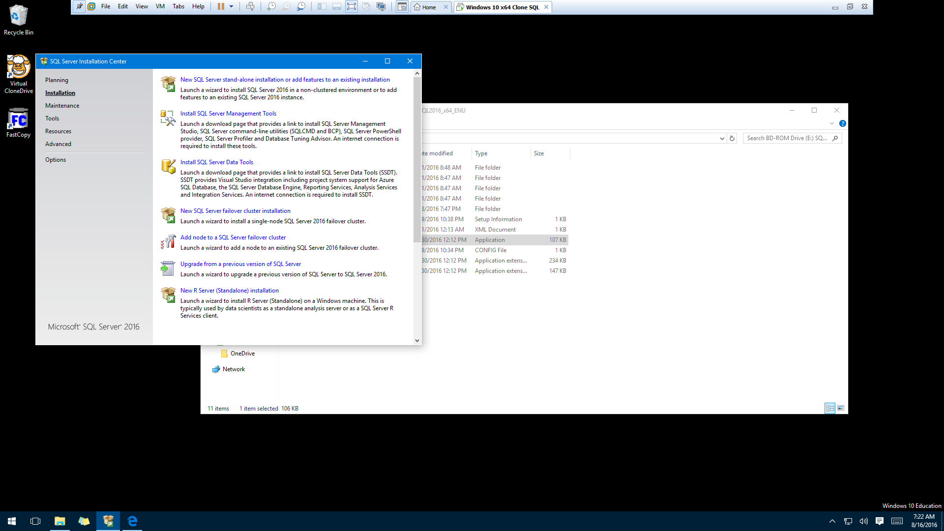
Select “New SQL Server…”

Slide 9
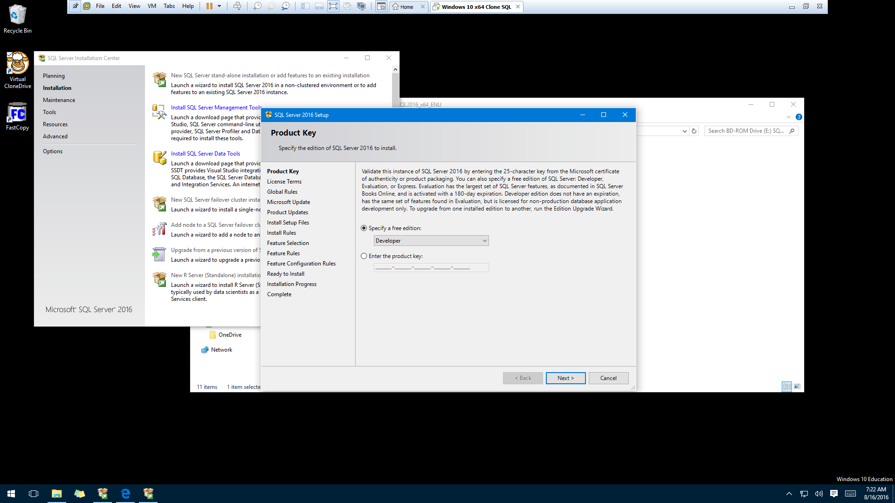
Select Default

Slide 11
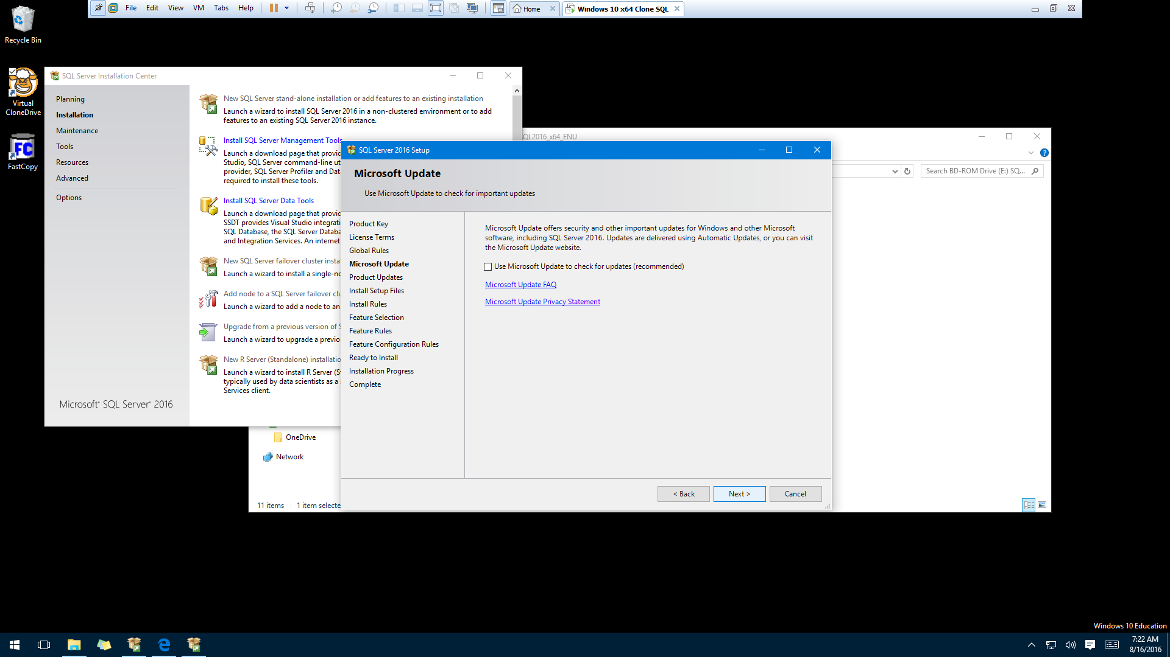

Slide 12
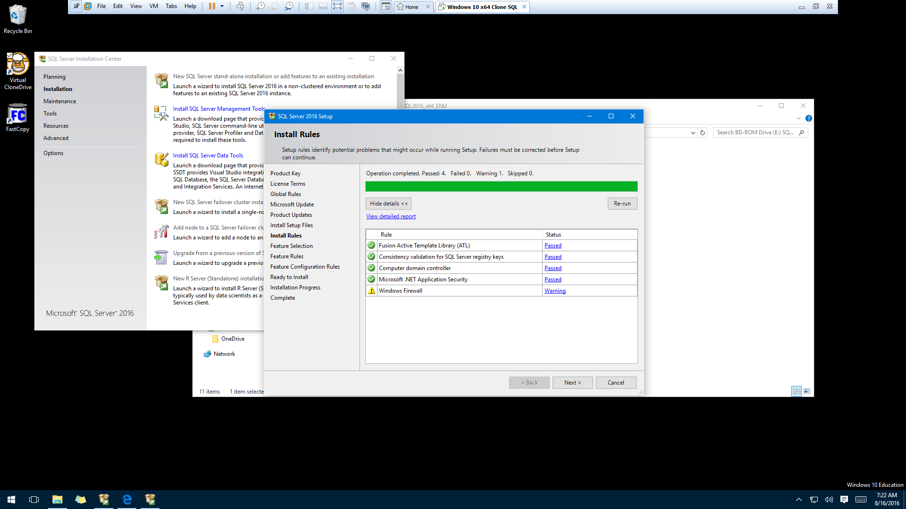
Ignore Windows Firewall Warning but everything else should succeed to proceed. If not, fix!

Slide 13
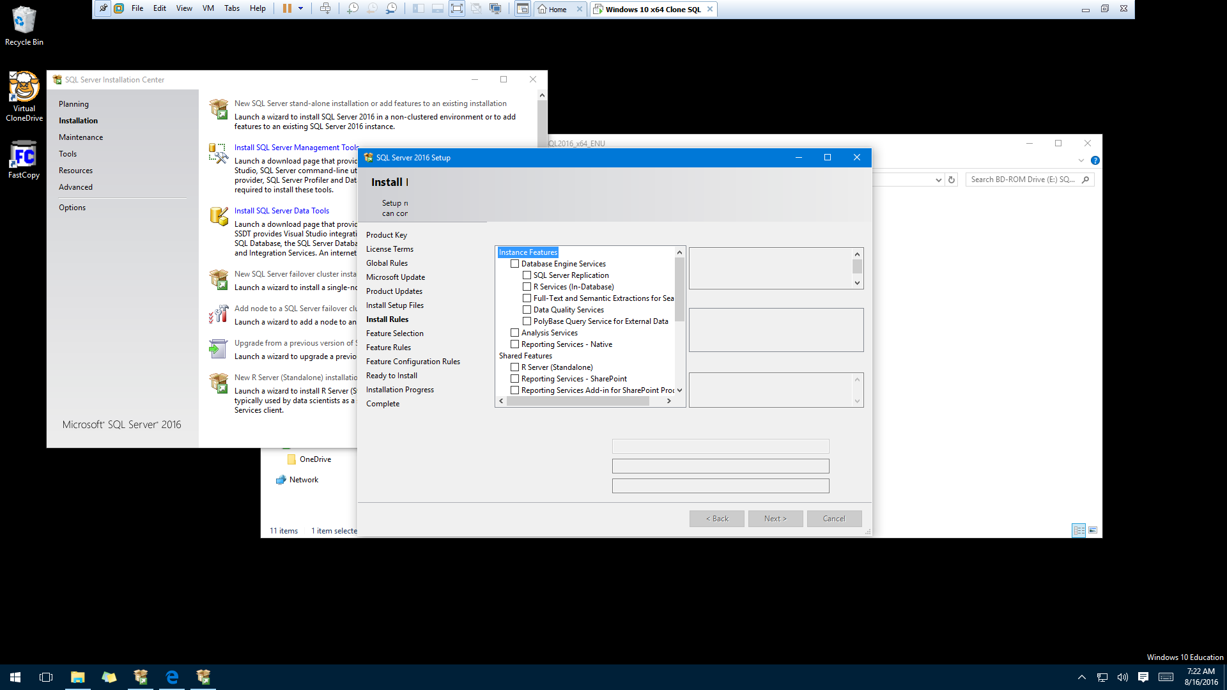
See next slide for selections

Slide 14
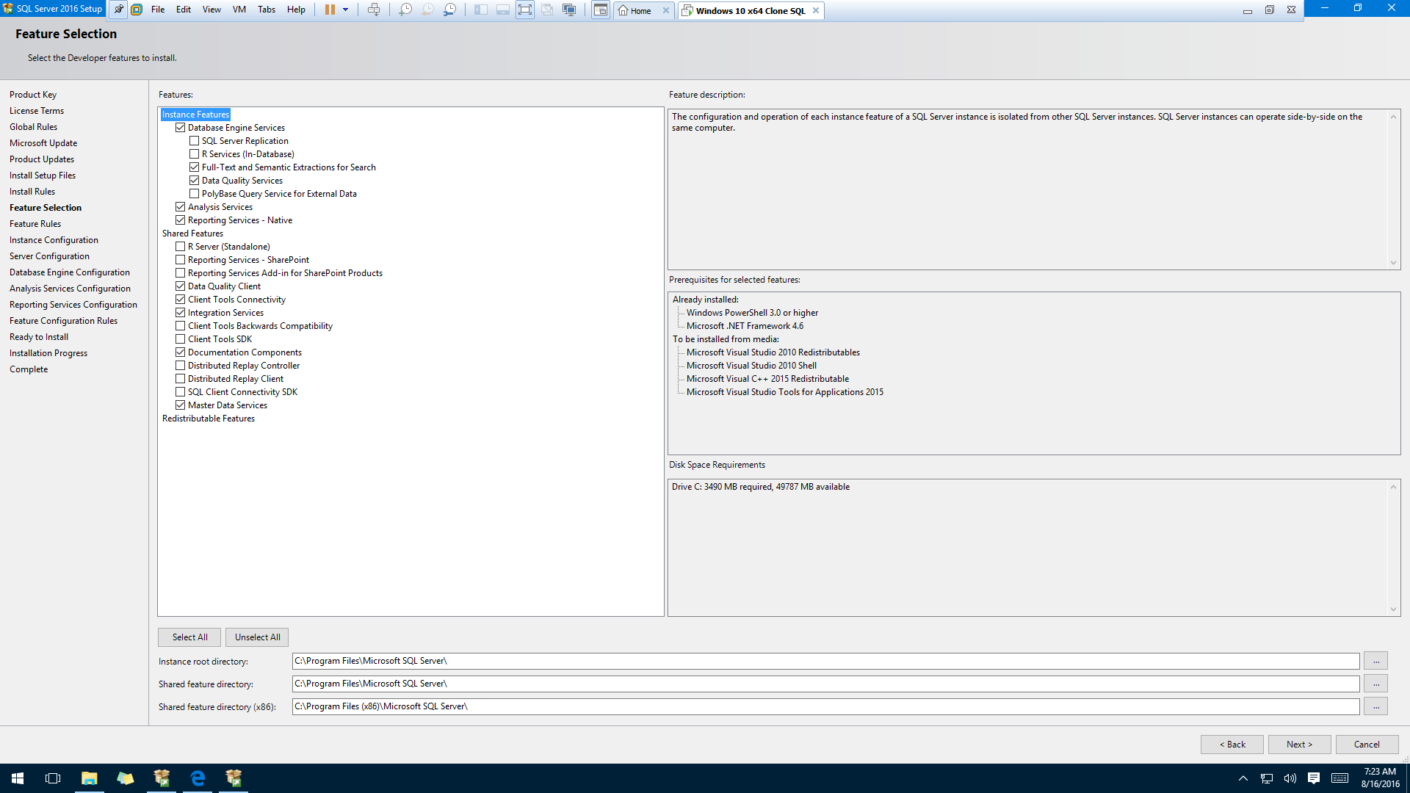
Installation Options

Slide 15
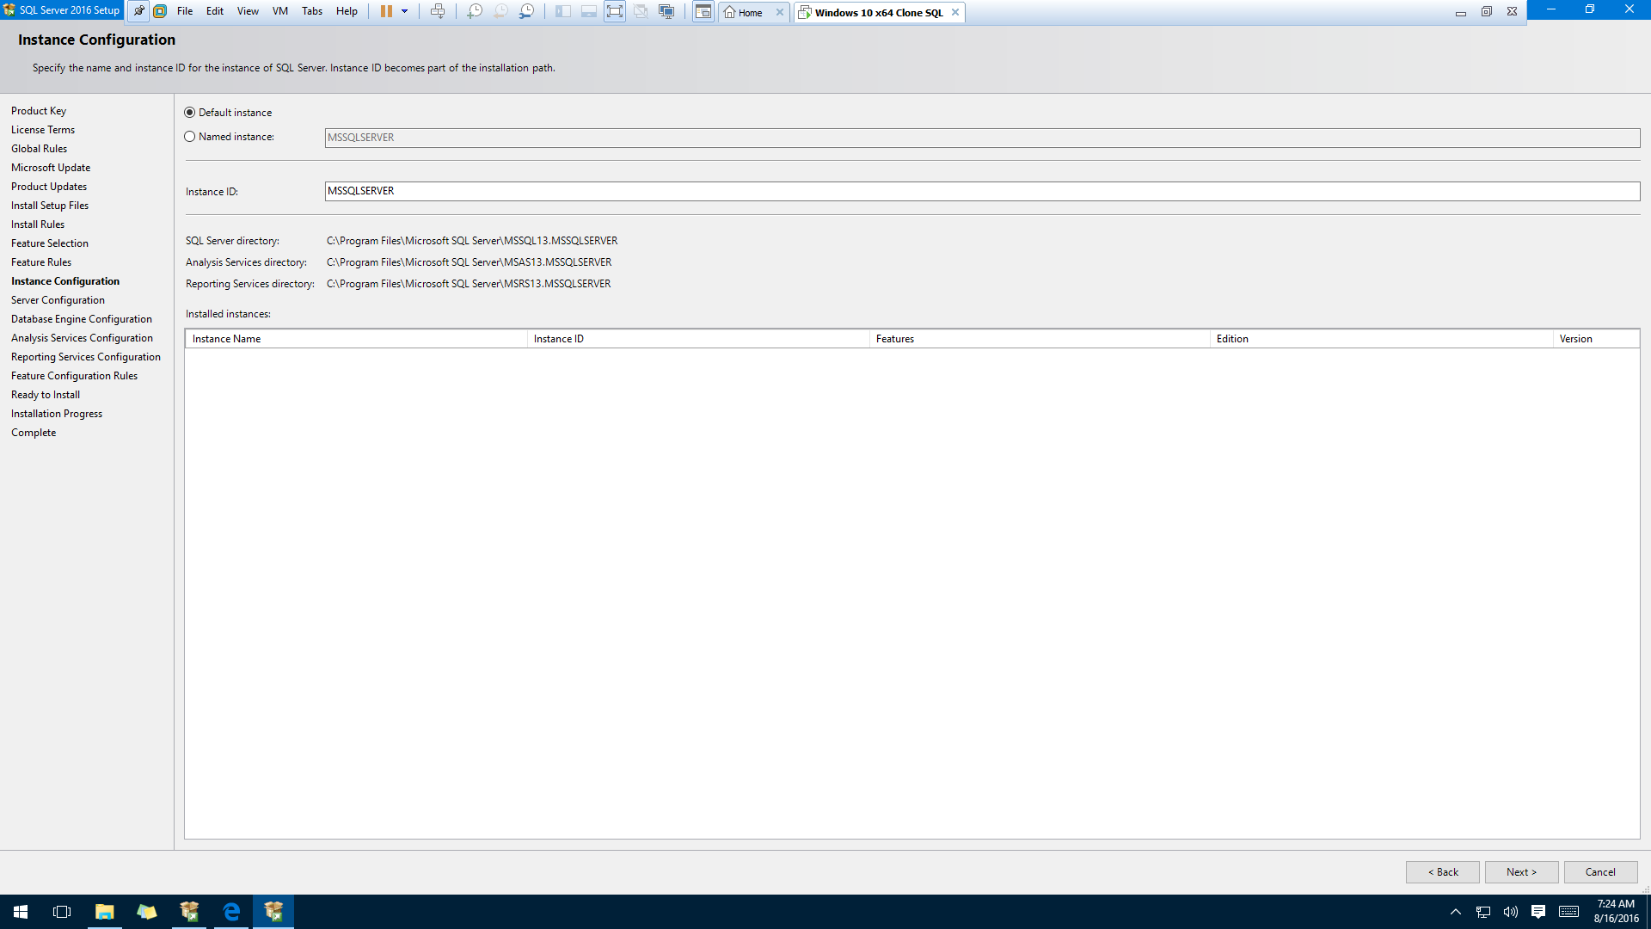
Use Default
Installation Options

Slide 16
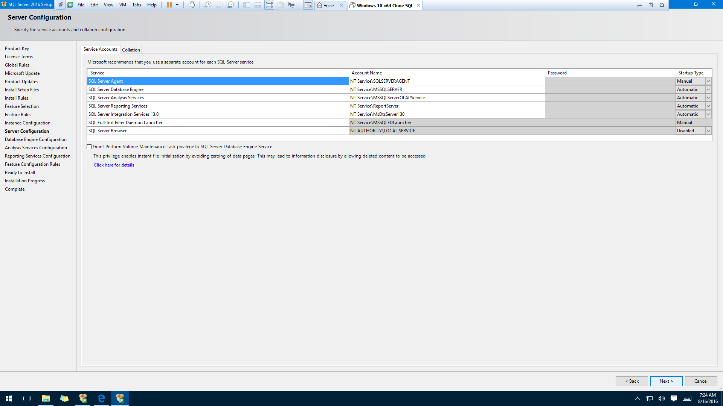
Use Default
Installation Options
Use Default
Installation
Options

Slide 17
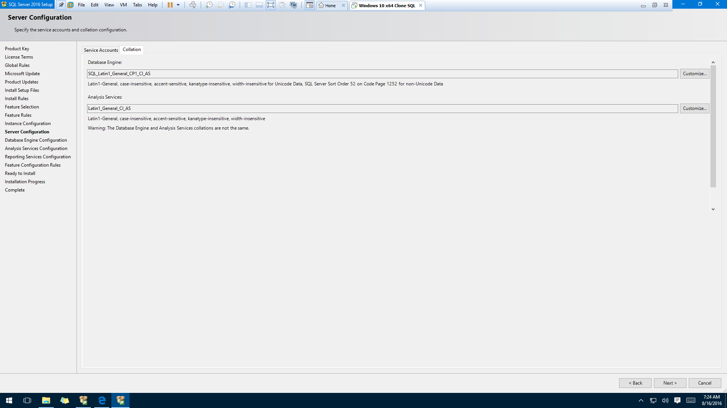
Use Default
Installation
Options

Slide 18
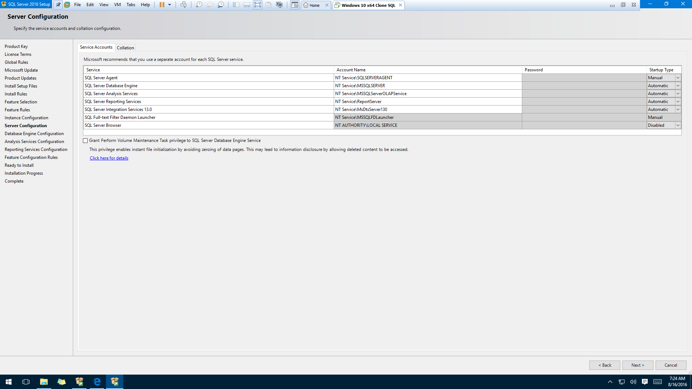
Use Default
Installation
Options

Slide 19
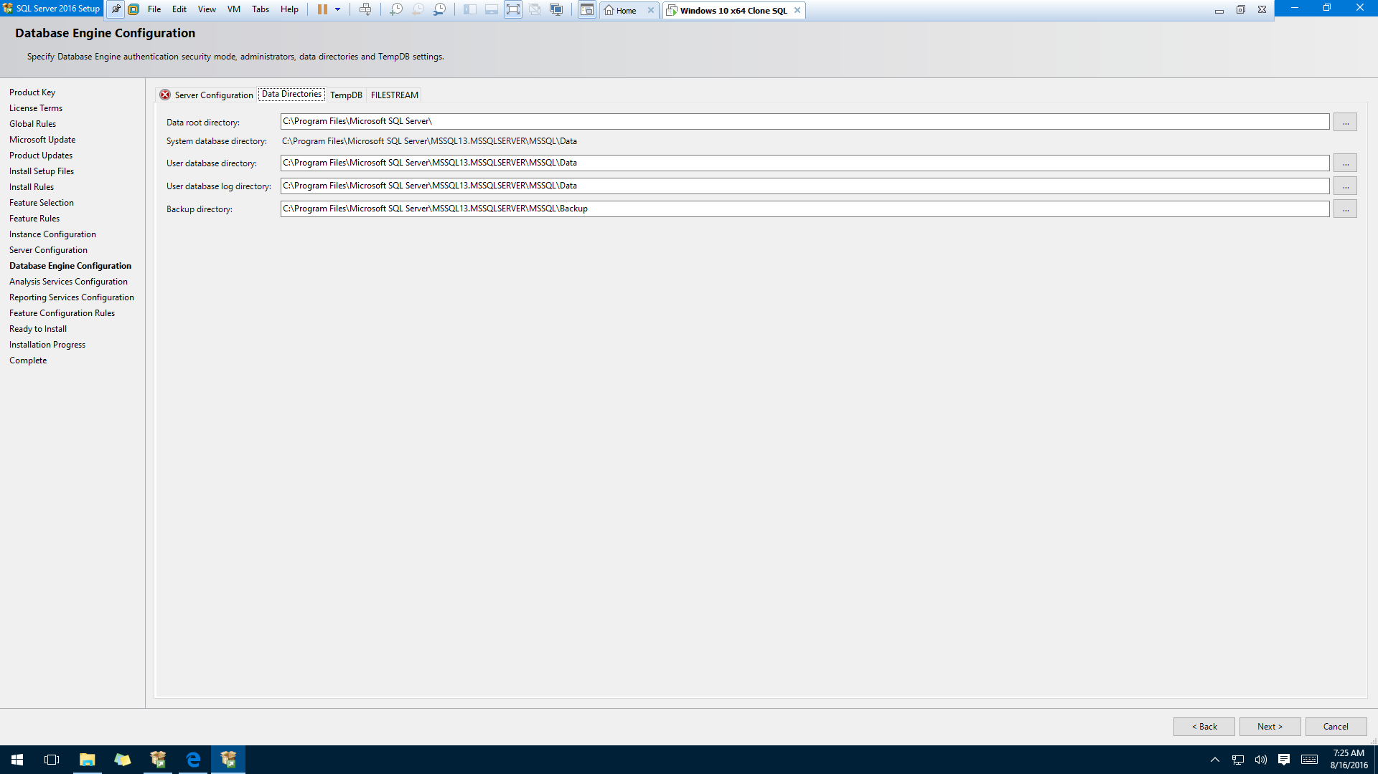
You can use Default Installation Options but next slide is an example of what I do…

Slide 20
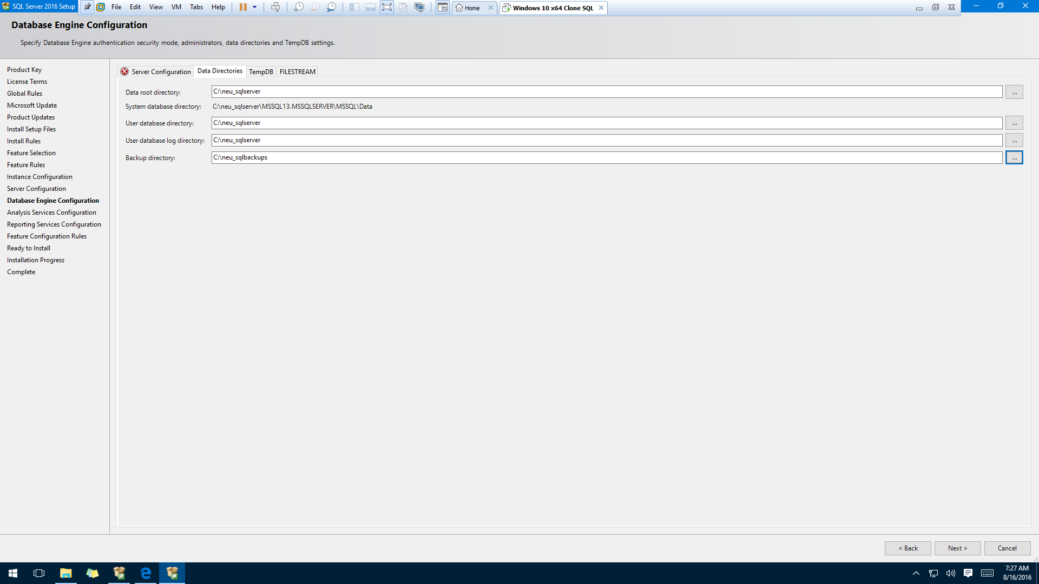
I use different locations – more easily found & does not change with version

Slide 21
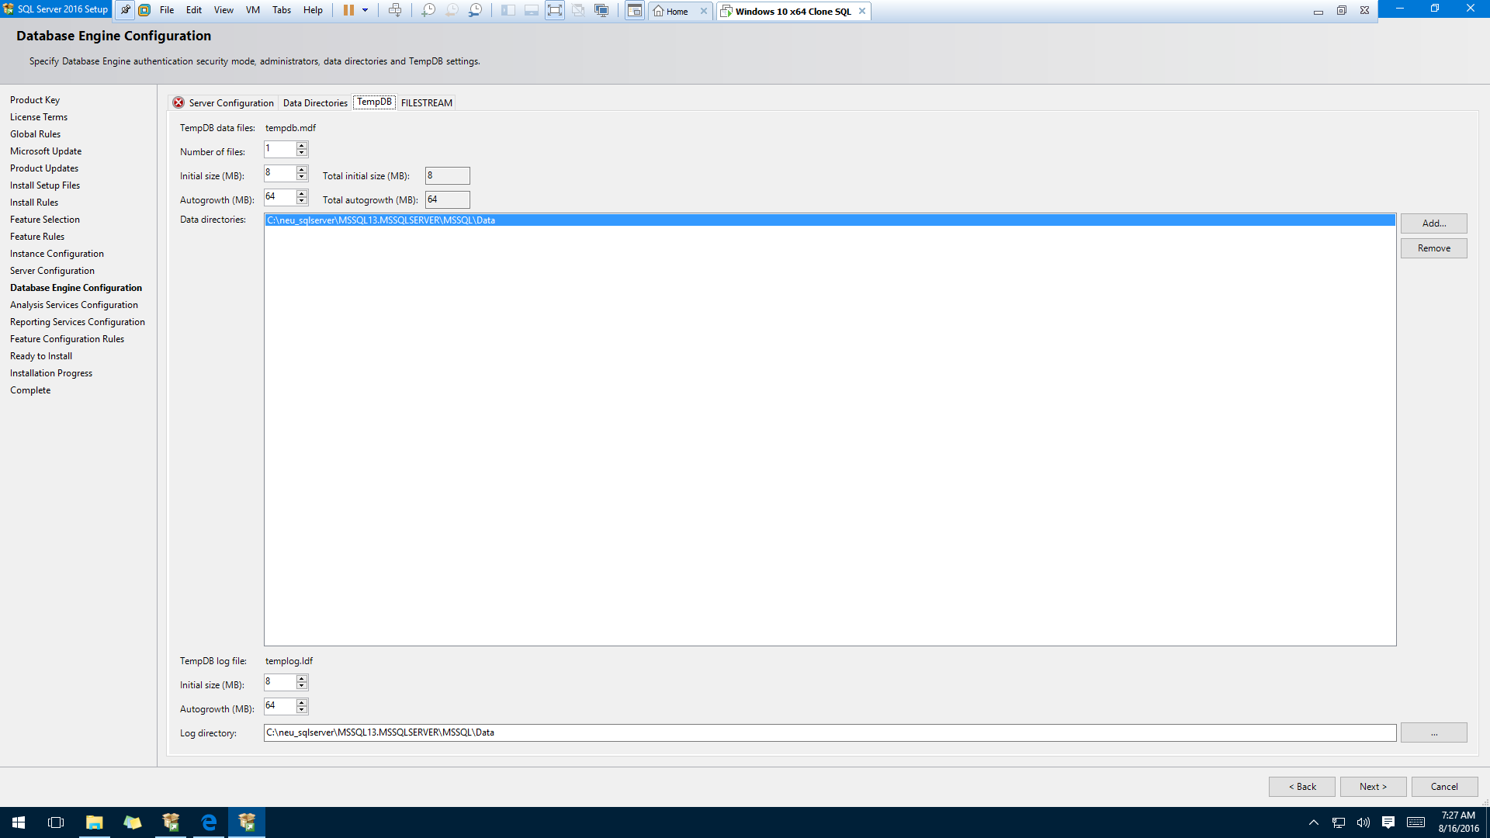

Slide 22
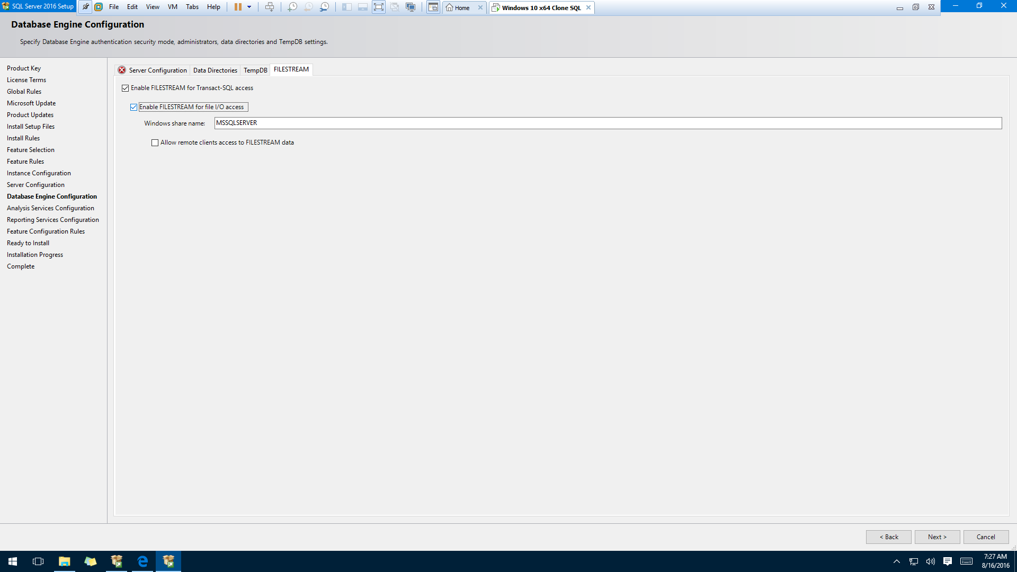

Slide 23
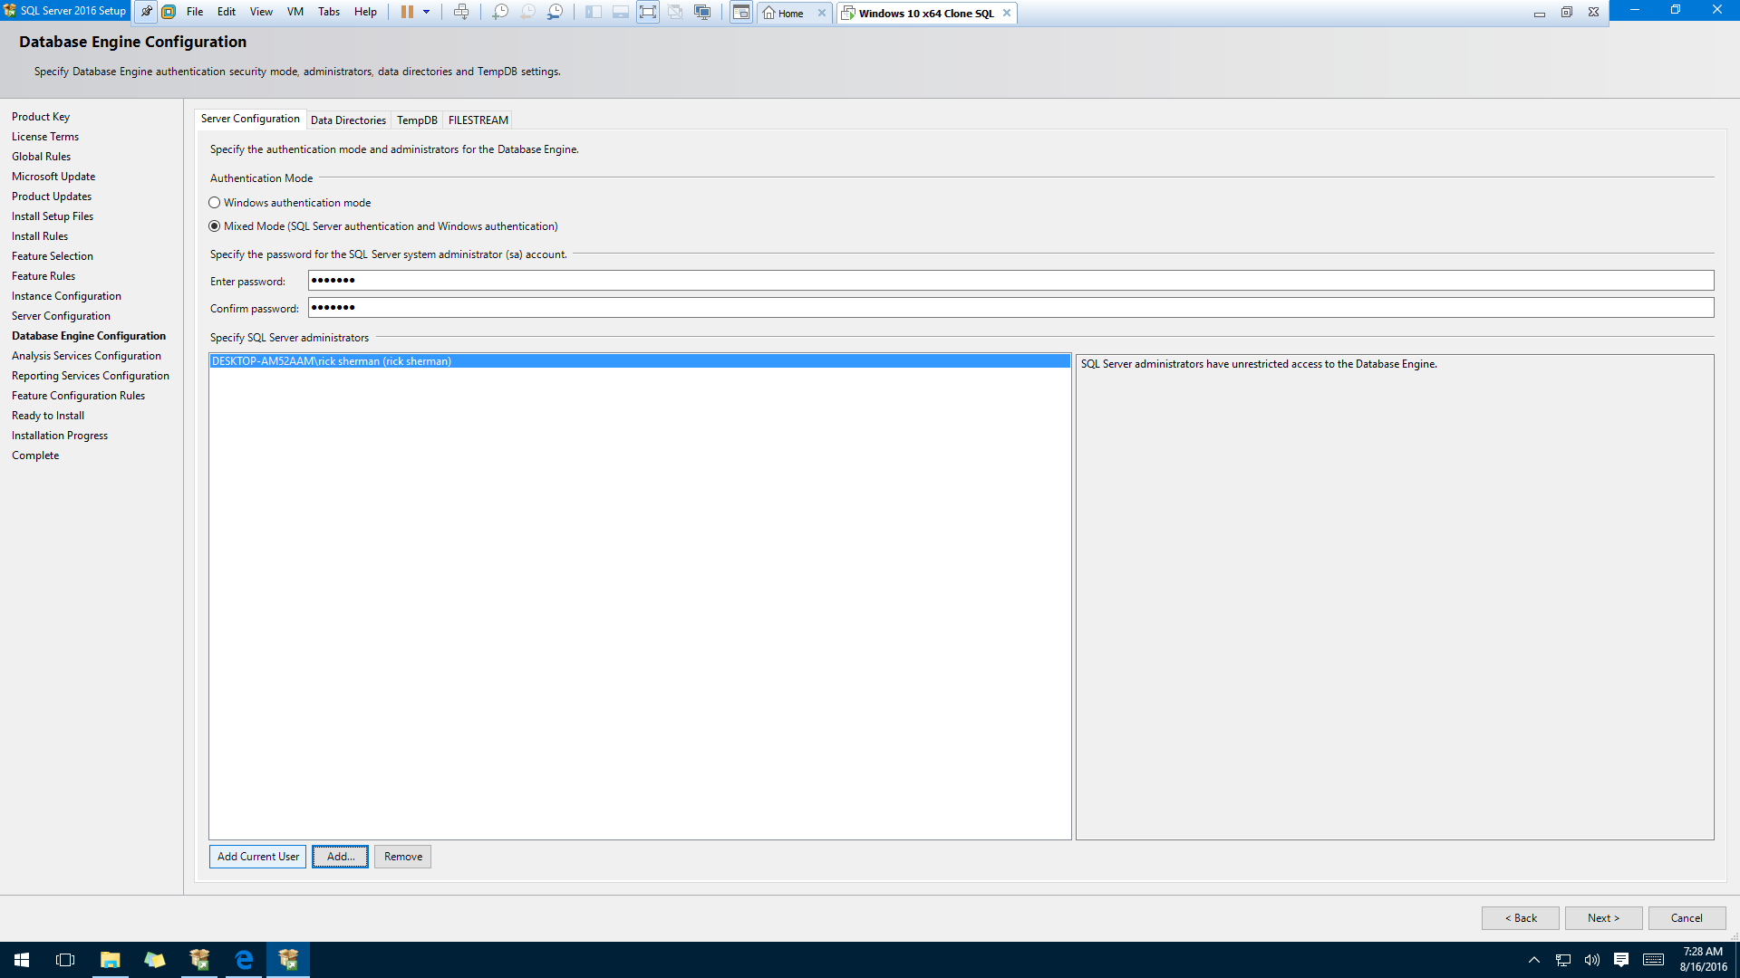
Select Mixed Mode Authentication
This is password for you “sa” account in SQL Server.
Hints:
Save it somewhere
Use same password for all your database accounts
Specify SQL Server Admin – your Windows login account

Slide 24
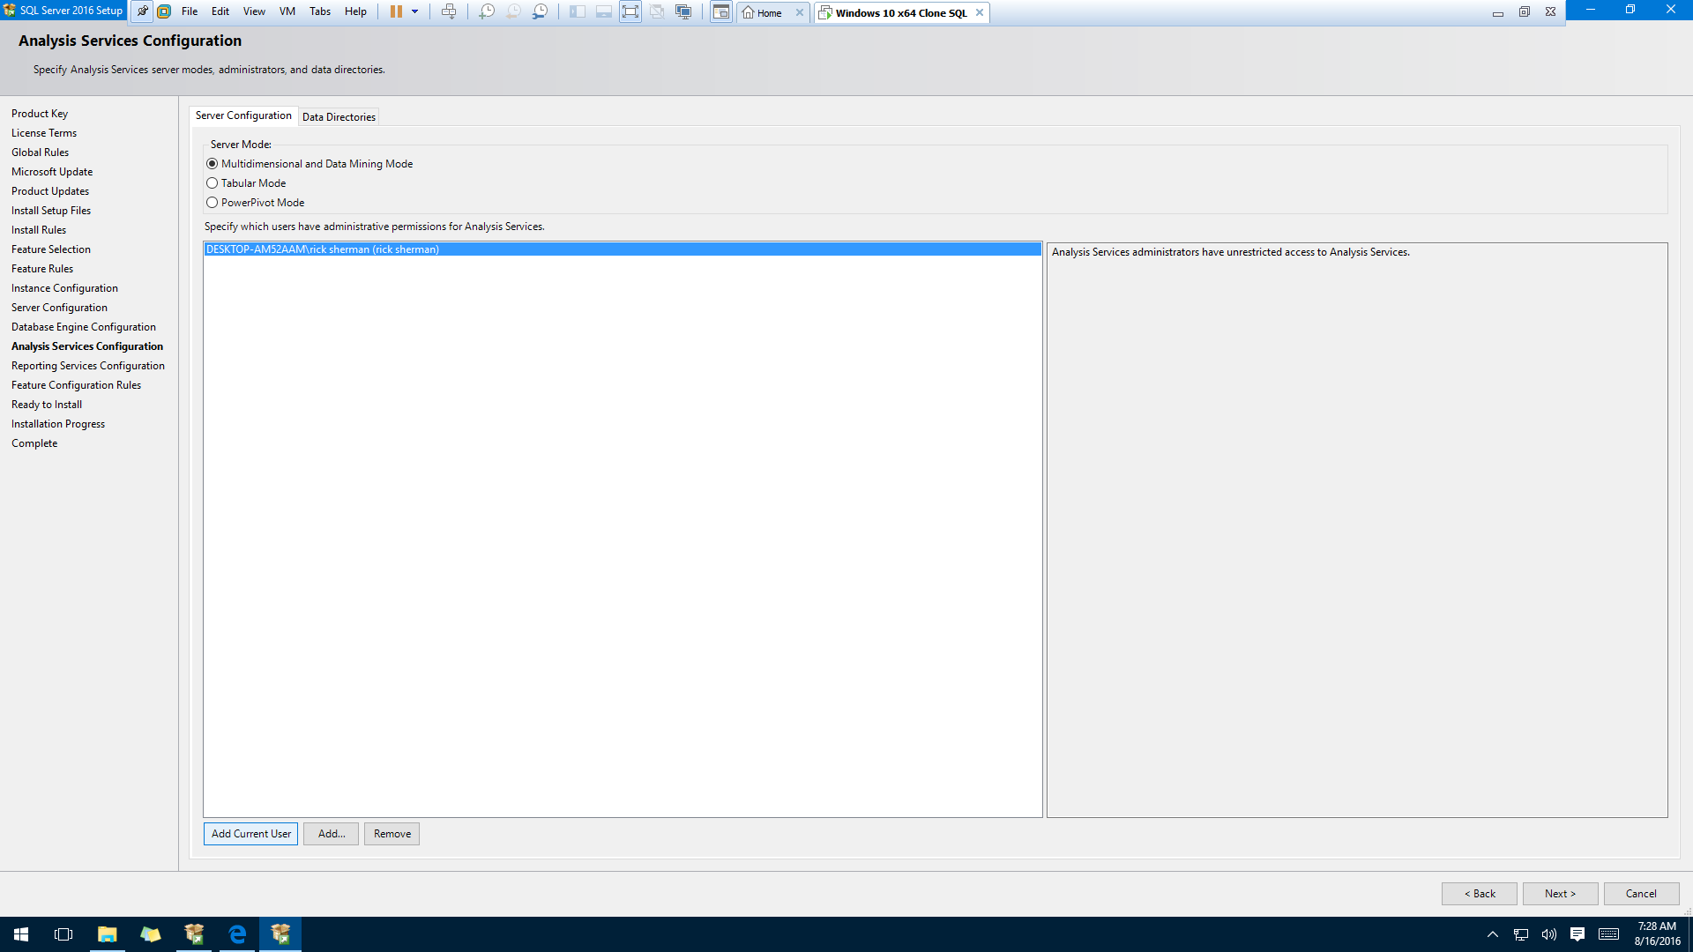
Select Multidimensional (Default)
Specify SQL Server Admin – your Windows login account

Slide 25
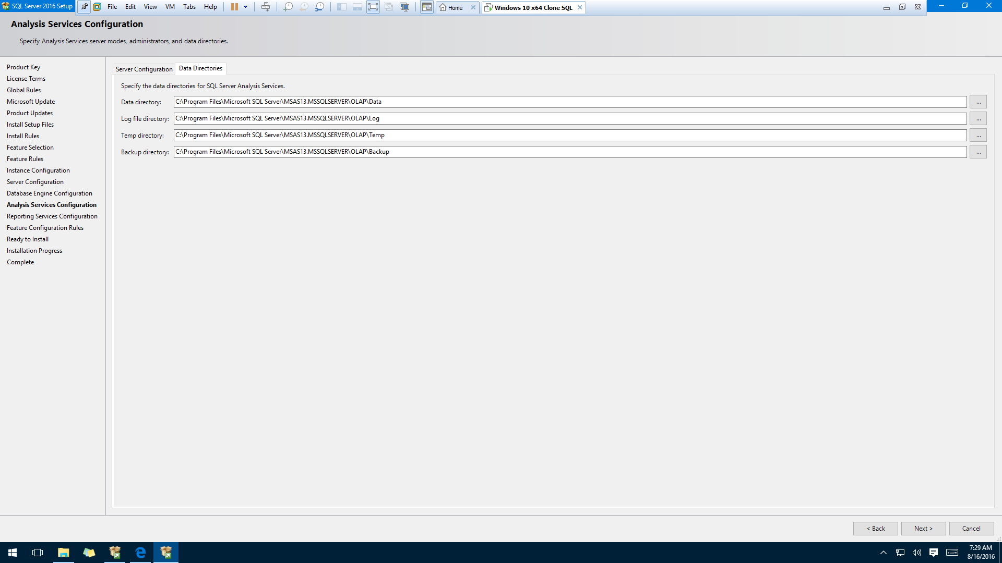
You can use Default Installation Options but next slide is an example of what I do…

Slide 26
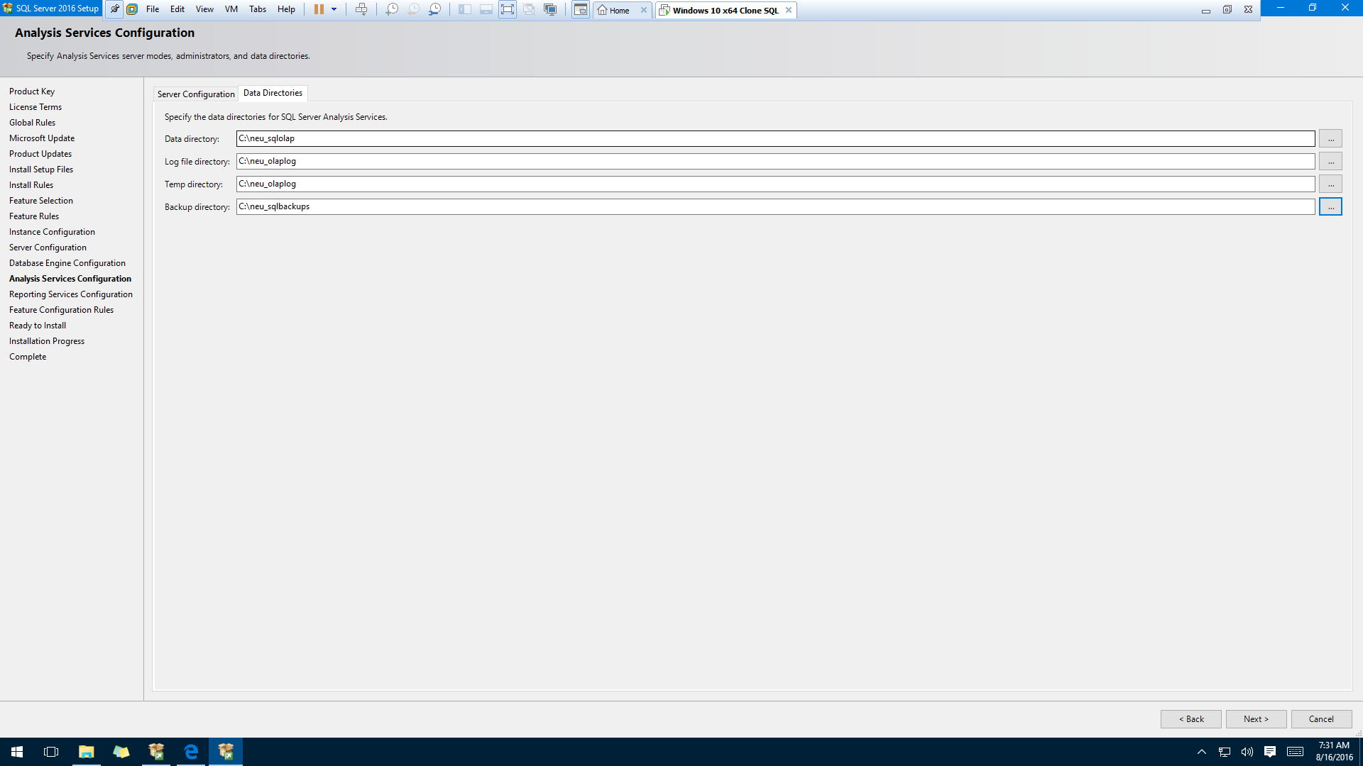
I use different locations – more easily found & does not change with version

Slide 27
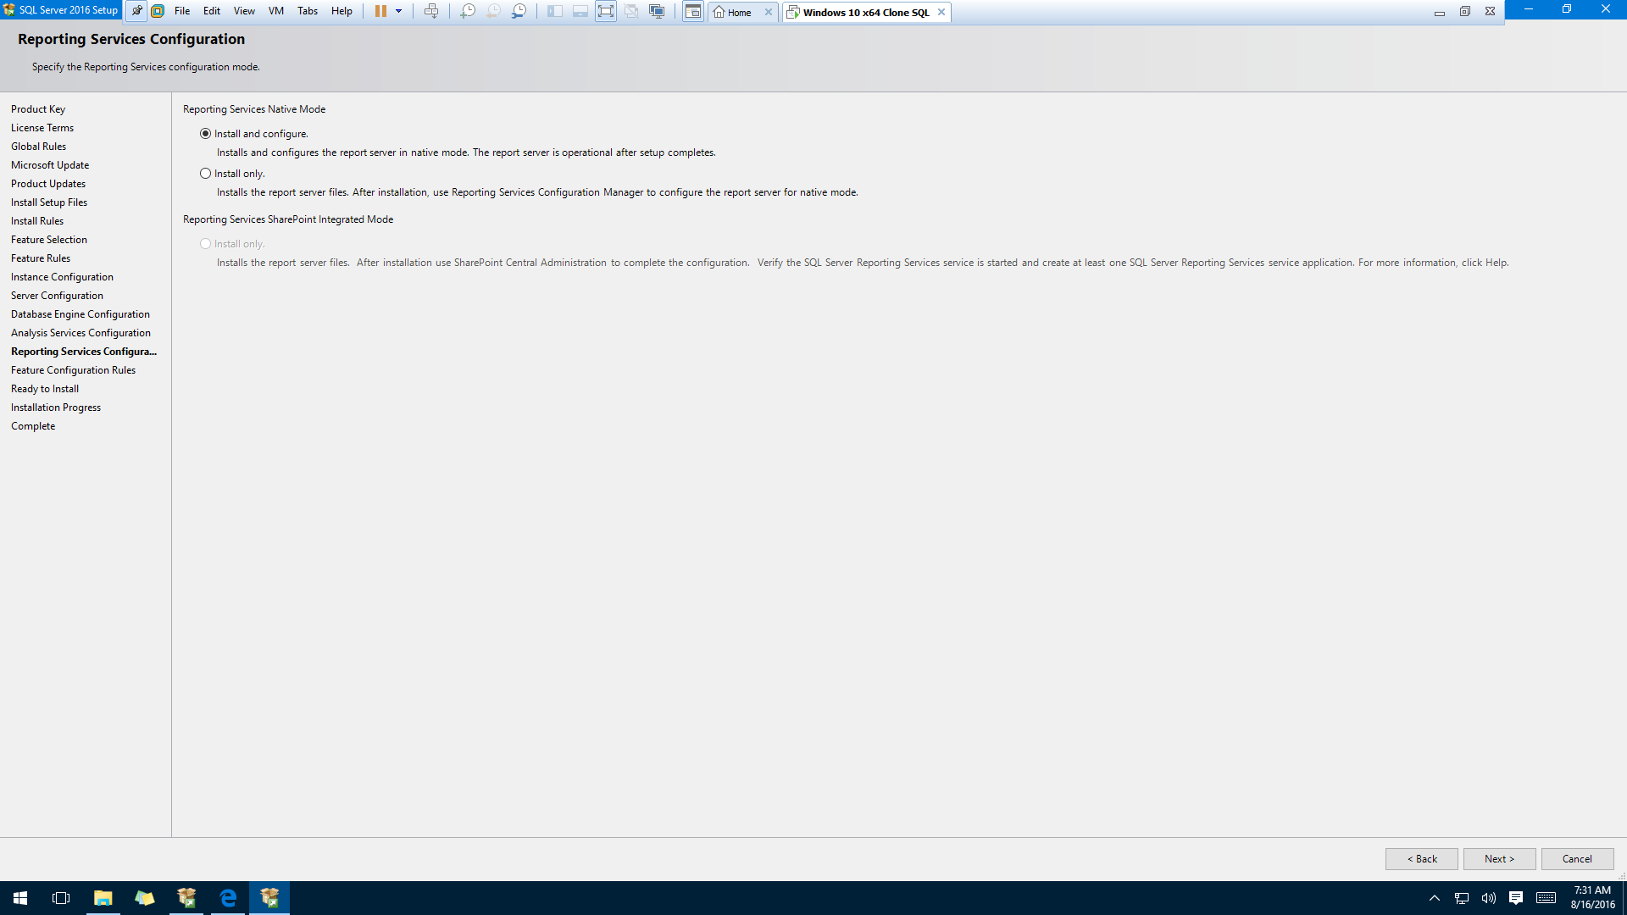
Use Default
Installation
Options

Slide 28
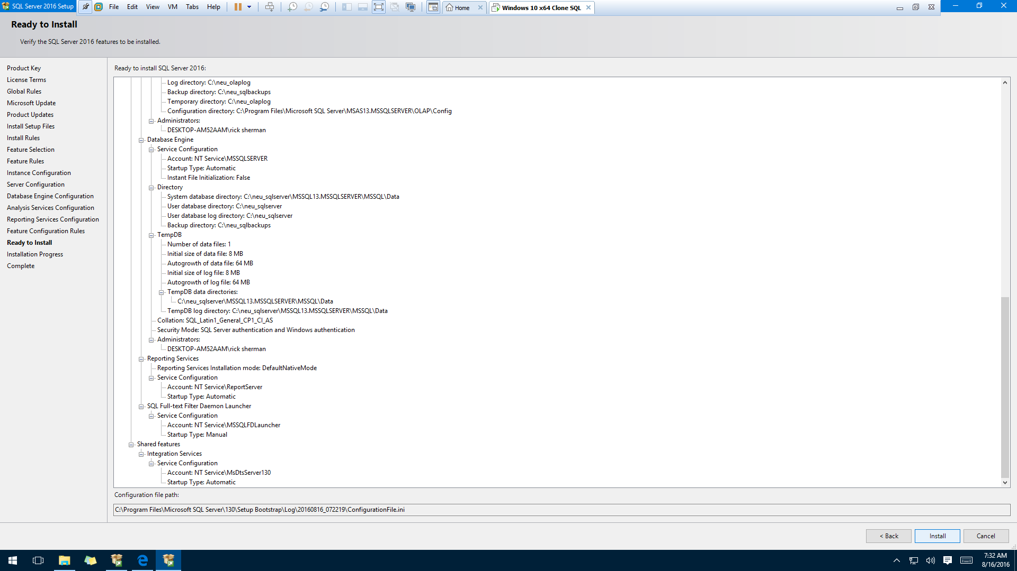
This confirms what you selected.
Select Install.

Slide 29
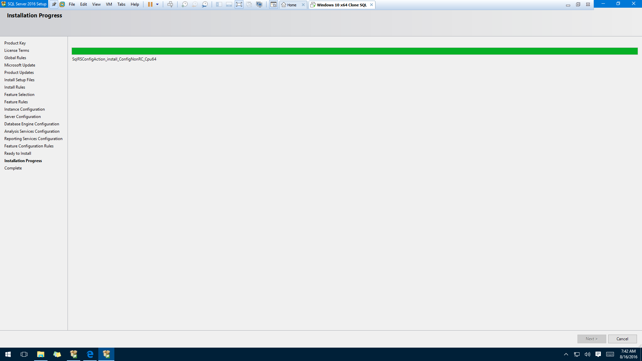

Slide 30
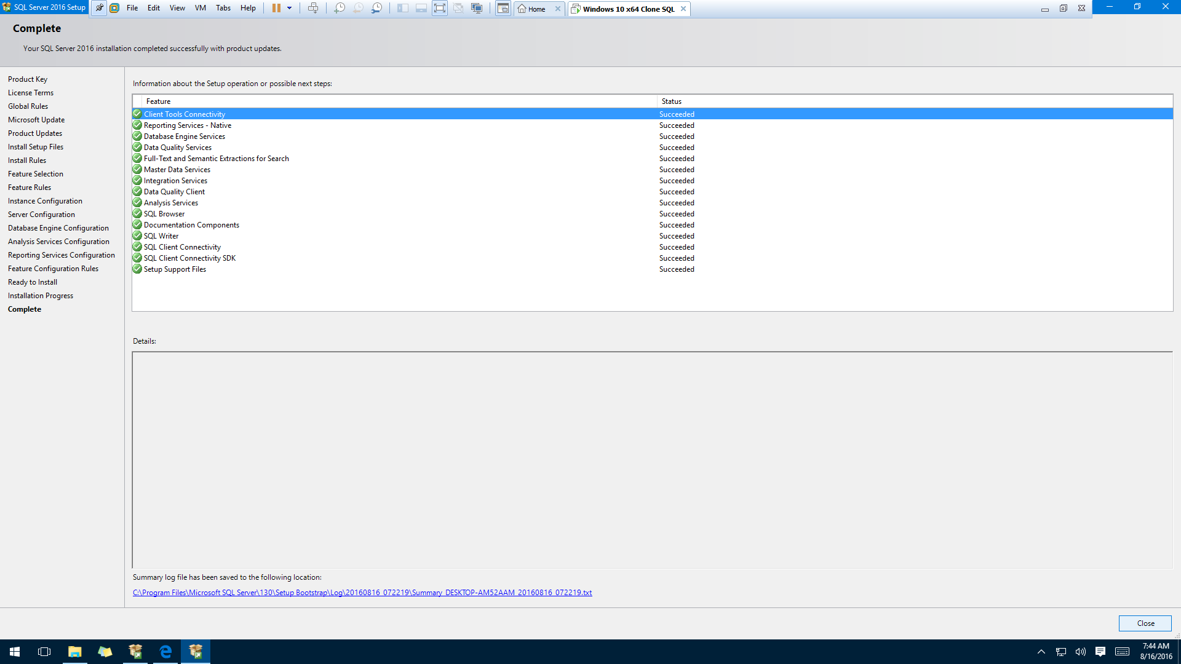
Check if everything succeeded!!!
If NOT then redo or ask for help
Hints:
1) Create a screen capture of this if you are asking for help

