Slide 1
The Admissions Funnel Dashboard
A Brief Overview

Slide 2
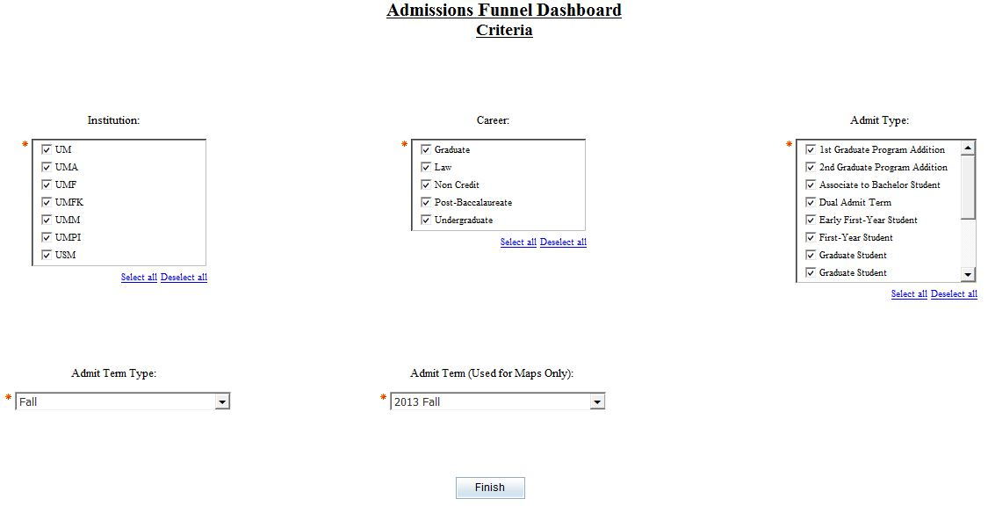
The Admissions Funnel Dashboard Criteria Page
Institution allows you to choose one or more institutions to include in your report. To get all institutions you must select them all.
Admit Type is used by all of the reports. Not all Admit Types apply to all Careers.
Career allows you to choose one or more careers to include in your report. To get all careers you must select them all.
Admit Term Type is used for all reports except the Applicants map.
Admit Term is used by Applicants map.

Slide 3
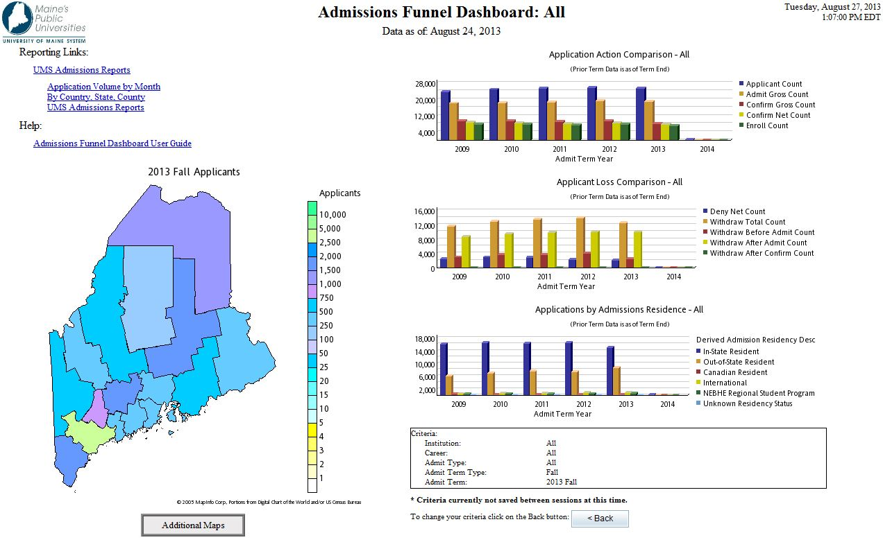
The Admissions Funnel Dashboard

Slide 4
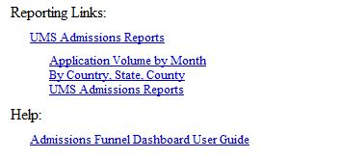
The Reporting Links on your dashboard allow you to link directly to other pre-written reports that you can execute.

Slide 5
The criteria box displays the selections that you made on the criteria page. This allows you to quickly see what criteria is effecting the individual reports. Some criteria is used for specific reports such as Admit Term which is only used by the Applicants map.
The Back Button allows you to return to the criteria page to change your selections and rerun the report.

Slide 6
The Application Action Comparison Report gives you a graphical view of the number of applications and their progression through enrollment over a 6 year time frame. Current and future terms may be incomplete. The data for this report comes from the Admissions Funnel data mart and is valid as of the date stated in the report heading. This report allows a drill through to a more detailed report.

Slide 7
The Applicant Loss Comparison Report gives you a graphical view of the number of applications that have been denied or the applicant has withdrawn over a 6 year time frame. Current and future terms may be incomplete. The data for this report comes from the Admissions Funnel data mart and is valid as of the date stated in the report heading. This report allows a drill through to a more detailed report.

Slide 8
The Applications by Admissions Residence Report gives you a graphical view of the number of applications and where they are applying from over a 6 year time frame. Current and future terms may be incomplete. The data for this report comes from the Admissions Funnel data mart and is valid as of the date stated in the report heading. This report allows a drill through to a more detailed report.

Slide 9
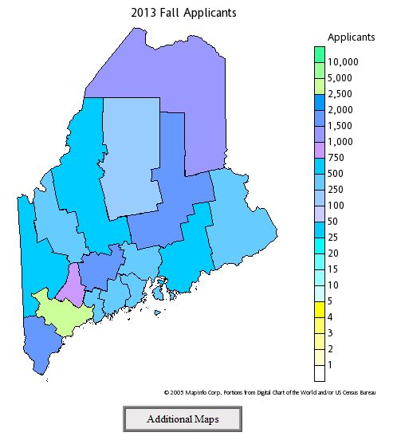
The Applicants map gives you a graphical view of the number of students who have applied by county for the chosen term. The data for this report comes from the Admissions Funnel data mart. This report allows a drill through to additional maps.

