Slide 1
The Admissions Quality Dashboard
A Brief Overview

Slide 2
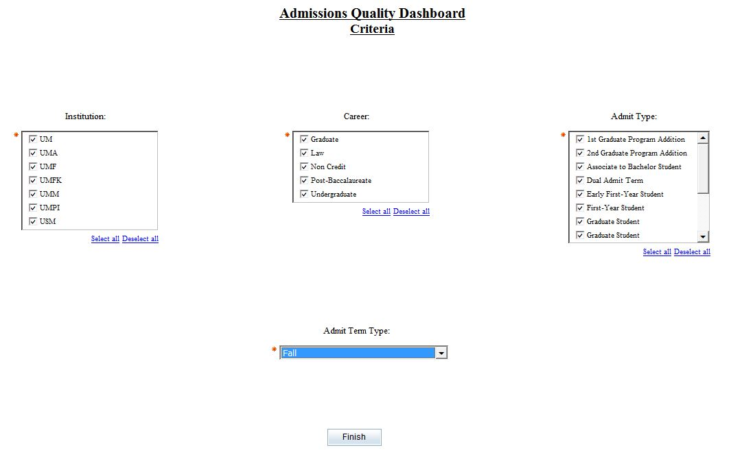
The Admissions Quality Dashboard Criteria Page
Institution allows you to choose one or more institutions to include in your report. To get all institutions you must select them all.
Admit Type is used by all of the reports. Not all Admit Types apply to all Careers.
Career allows you to choose one or more careers to include in your report. To get all careers you must select them all.
Admit Term Type defines which terms to compare.

Slide 3
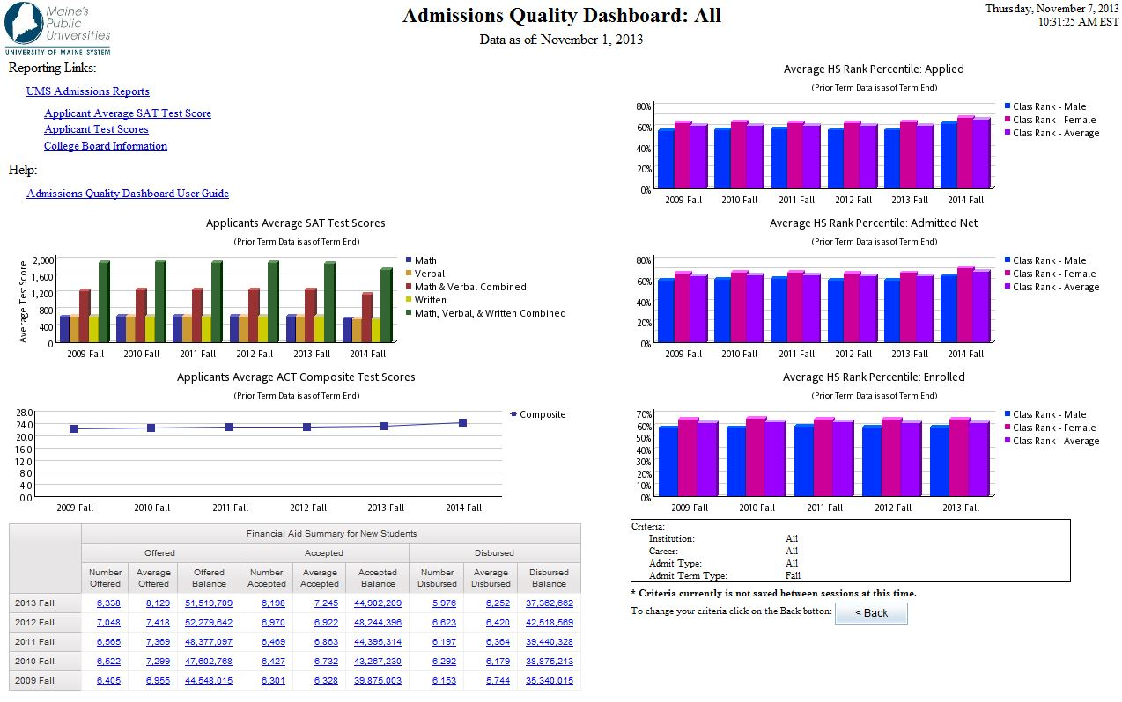
The Admissions Quality Dashboard

Slide 4
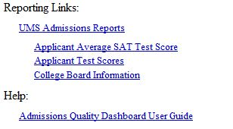
The Reporting Links on your dashboard allow you to link directly to other pre-written reports that you can execute.

Slide 5
The criteria box displays the selections that you made on the criteria page. This allows you to quickly see what criteria is effecting the individual reports.
The Back Button allows you to return to the criteria page to change your selections and rerun the report.

Slide 6
The Application Average SAT Test Score Report gives you a graphical view of the average SAT test scores over a 6 year time frame. Combined scores only include students that have taken all of the required tests. Current and future terms may be incomplete. The data for this report comes from the Admissions Funnel data mart and is valid as of the date stated in the report heading. This report allows a drill through to a more detailed report.

Slide 7
The Application Average ACT Test Score Report gives you a graphical view of the average ACT test scores over a 6 year time frame. Current and future terms may be incomplete. The data for this report comes from the Admissions Funnel data mart and is valid as of the date stated in the report heading. This report allows a drill through to a more detailed report.

Slide 8
The Financial Aid Summary for New Students Report gives you information regarding financial aid over a 5 year time frame. Current and future terms may be incomplete. New Student status is determined using the New Student Flag which is set to ‘Y’ when Term is equal to Derived Admit Term. The data for this report comes from the Financial Aid data mart and is valid as of the date stated in the report heading. This report allows a drill through to a more detailed report.

Slide 9
The Average HS Rank Percentile: Applied Report gives you a graphical view of the average rank of all students that have applied over a 6 year time frame. Current and future terms may be incomplete. The data for this report comes from the Admissions Funnel data mart and is valid as of the date stated in the report heading. This report allows a drill through to a more detailed report.

Slide 10
The Average HS Rank Percentile: Admitted Net Report gives you a graphical view of the average rank of all students that have been admitted over a 6 year time frame. Current and future terms may be incomplete. The data for this report comes from the Admissions Funnel data mart and is valid as of the date stated in the report heading. This report allows a drill through to a more detailed report.

Slide 11
The Average HS Rank Percentile: Enrolled Report gives you a graphical view of the average rank of all students that have enrolled over a 6 year time frame. Current and future terms may be incomplete. The data for this report comes from the Admissions Funnel data mart and is valid as of the date stated in the report heading. This report allows a drill through to a more detailed report.

